Slide 1
Vocabulary Review
Mrs. McKay
9.2

Slide 2
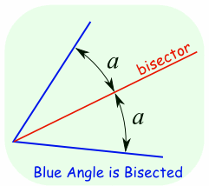
Angle Bisector

Slide 3
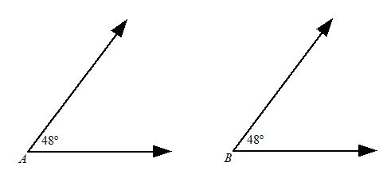
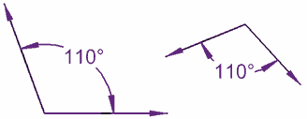
Congruent Angles
Two angles that are exactly the same in measure.

Slide 4
Angles – sides and vertex
There is another case where two rays can have a common endpoint.
angle
This figure is called an _____.
S
Some parts of angles have special names.
side
vertex
The common endpoint is called the ______,
and the two rays that make up the sides of the angle are called the sides of the angle.
R
side
T
vertex

Slide 5
Straight Angles
Opposite rays
___________ are two rays that are part of a the same line and have only their endpoints in common.
Y
X
Z
opposite rays
XY and XZ are ____________.
The figure formed by opposite rays is also referred to as a ____________. A straight angle measures 180 degrees.
straight angle

Slide 6
Right Angles
Angles with one corner equal to 90 degrees
It doesn’t matter which way the corner is facing

Slide 7
Acute Angles
Angles with one corner less than 90 degrees
It doesn’t matter which way the corner is facing

Slide 8
Obtuse Angles
Angles with one corner greater than 90 degrees
It also doesn’t matter which way the corner is facing

