Slide 1
Slope Review
Mrs. McKay
February 20, 2013 and
February 21, 2013

Slide 2
SLOPE FORMULA
$$\frac{ (y2 −y1)}{ (x2−x1)}$$
TO FIND SLOPE YOU MUST HAVE TWO POINTS!!!!!
TO FIND SLOPE YOU MUST HAVE TWO sets of coordinates!!!!!
TO FIND SLOPE YOU MUST HAVE TWO POINTS!!!!!
TO FIND SLOPE YOU MUST HAVE TWO sets of coordinates!!!!!

Slide 3
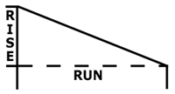
SLOPE
A measure of a line’s steepness AND
the ratio of rise to run.
$\frac{rise}{run}$= $\frac{\text{vertical} \text{change} (y2 −y1)}{horizontal change (x2−x1)}$

Slide 4
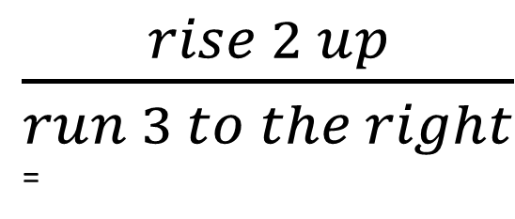
How to PLOT with ONLY SLOPE
Start at origin – (0,0)
Turn the slope to a fraction. Follow the directions in the slope
Example: 2/3 says
Make a point on the graph after you RUN.
REPEAT -You should have at least 3 points for each line.
$\frac{rise 2 up}{run 3 to the right}$=

Slide 5
How to PLOT with SLOPE and a PT
Start at given point.
Turn the slope to a fraction. Follow the directions in the slope
Example: 2/3 says
Make a point on the graph after you RUN.
REPEAT -You should have at least 3 points for each line.
$\frac{rise 2 up}{run 3 to the right}$=

Slide 6
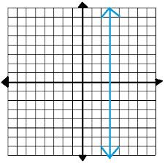
Undefined Slope
When a zero is in the denominator of the slope
Example: 2/0 = THIS CANNOT MATHEMATICALLY HAPPEN, so we call it undefined
This is a vertical line on the
graph

Slide 7
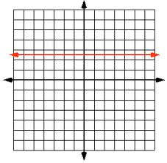
Zero Slope
When the numerator of slope is zero
Example → 0/2 = 0
This is a horizontal
line.

Slide 8
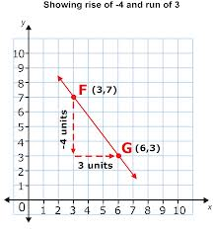
Example 1
Given one point (3,7) and slope $\frac{−4}{3}$

Slide 9
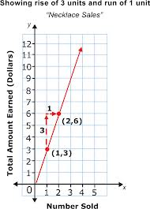
Example 2
If given a point, (1,3) and slope 3

Slide 10
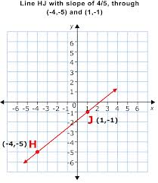
Example 3
If given a point
(-4,-5) and slope $\frac{4}{5}$

Slide 11
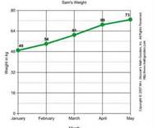
Constant Rates of Change
Constant Rates of Change – only one x value for each y value, usually a straight line that does not change direction

Slide 12
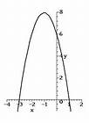
Variable Rates of Change
Variable Rates of Change – more than one x for one y value, usually a curved or circled graph

