Slide 1
SLOPE INTERCEPT FORM
Mrs. McKay
March 5, 2013

Slide 2
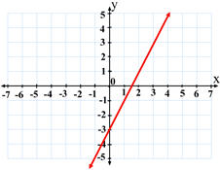
Linear Equation
A linear equation is an equation whose graph is a straight line in the coordinate plane.
Example: y = 2x - 3 is a linear equation because its graph (the red line) is a straight line.

Slide 3
Slope Intercept Form
y = mx + b
The equation of a line where
M = slope
B = y - intercept

Slide 4
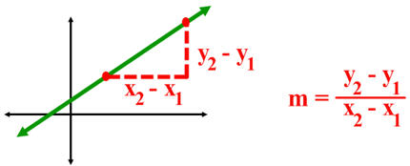
Slope

Slide 5
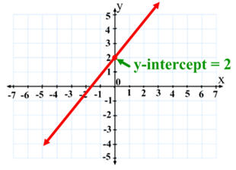
Y - Intercept
The y-intercept is where the line crosses the y-axis.

Slide 6
HOW TO GRAPH with slope intercept form
Identify the slope - m
Identify the y-intercept - b
Plot the y-intercept (0, b)
Turn the slope into a fraction.
Follow the slope directions rise/run
REPEAT at least 2 times for 3 points. Connect the points for a straight line.

Slide 7
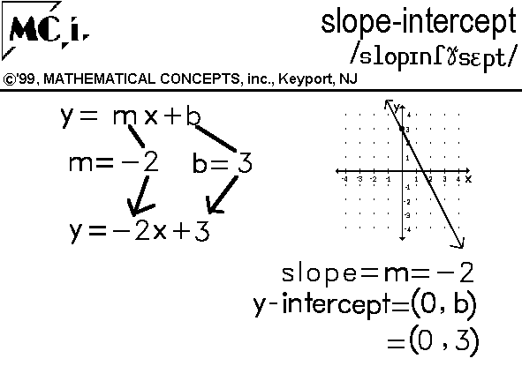
Example 1

Slide 8
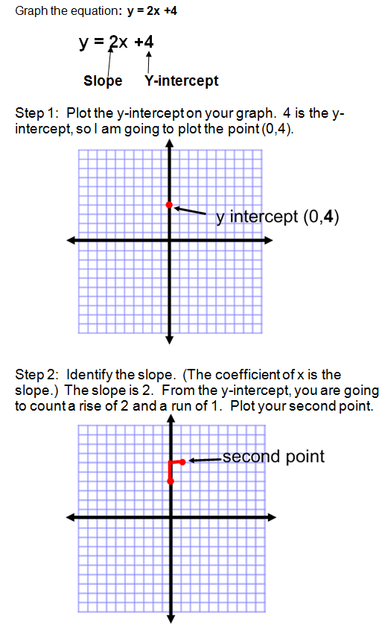
Example 2

