Slide 1
Multiplying & Dividing Decimals
Mrs. McKay
March 19, 2013

Slide 2
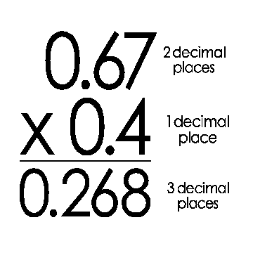

Slide 3
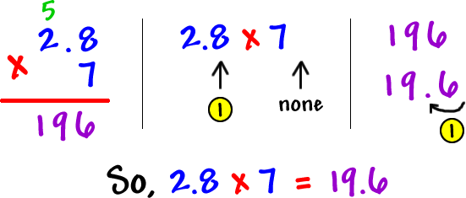

Slide 4
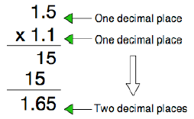

Slide 6
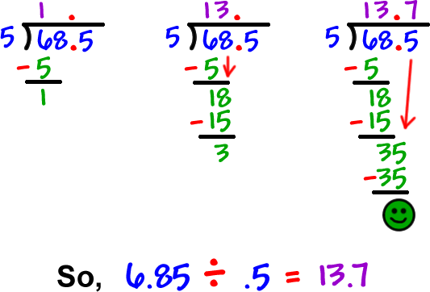

Slide 7
Dividing Decimals
What if you have 9 ÷ 1.25 ?
You MUST make the divisor (the number outside of the house) a whole number.
Multiply the divisor by 100 or move decimal TWO spaces.

Slide 8
Try this ONE
9 ÷ 1.25
Make 1.25 a whole number
1.25 X 100 = 125
Multiply BOTH numbers by 100
NOW it’s 900 ÷ 125
What’s the answer?

