Slide 1
Graphing 5.2
Mrs. McKay
February 11, 2013

Slide 2
REMEMBER!!!
(X , Y)
THE X IS FIRST
LEFT (NEGATIVE) TO RIGHT (POSITIVE)
THE Y IS SECOND
UP (POSITIVE) AND DOWN (NEGATIVE)
Example – How do we write 5 steps up from origin and 2 steps to left of origin?

Slide 3
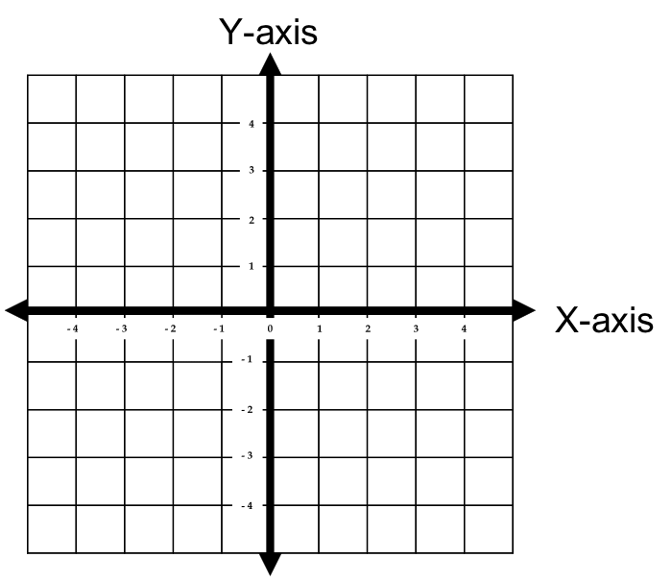

Slide 4
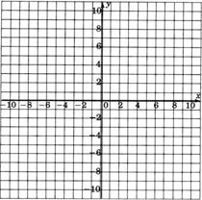

Slide 5
INTERPRETING GRAPHS
INCREASING GRAPHS – the x and y coordinates are increasing
DECREASING GRAPHS – the x and y coordinates are decreasing
CONSTANT GRAPHS – ONLY one coordinate is increasing or decreasing, ONE coordinate does not change.

Slide 6
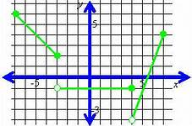
decreasingg
increasingg
constant

Slide 7
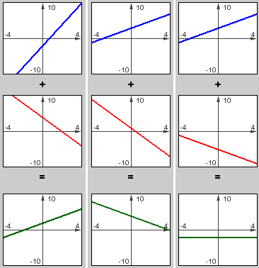
Notes:
When lines are going upward the graph is increasing – blue
When lines are going downward the graph is decreasing – red
When lines are flat, the graph is constant – last green one

Slide 8
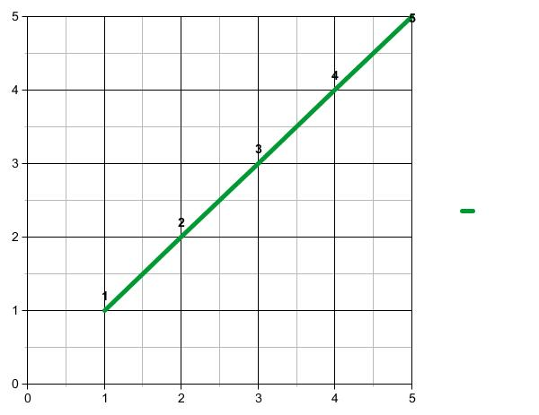
Notes:
When this graph is going up at a constant rate, the graph is increasing

Slide 9
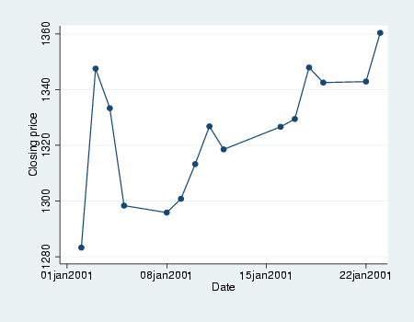
Notes:
Sharp increase, sharp decrease, down slow, up, down, up slow, up fast, down, constant, up fast

Slide 10
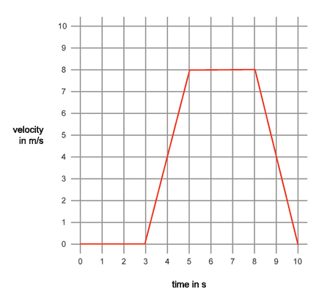
Distance in miles

Slide 11
PRACTICE
Turn to page 199
Follow all directions!
HINT: Draw your graph FIRST, then answer the questions.
IF YOU FINISH EARLY→
Turn to page 200
Do problems 1-7

