Slide 1
Adding and Subtracting Decimals
Mrs. McKay
March 18, 2013

Slide 2
Example 1
66.8 + 4 = ?

Slide 3
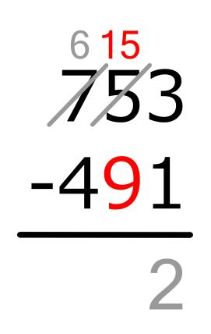
26

Slide 4
Interactivities
Chapter 3.1
http://my.hrw.com/math06_07/nsmedia/interactivities/mia011/mia011.html

