Slide 1
10.4 Review
Mrs. McKay
May 1, 2013

Slide 2
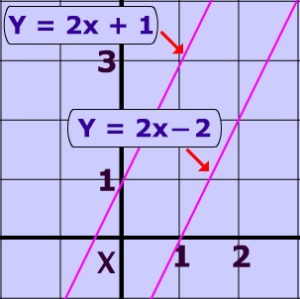
Parallel lines
Lines in the same plane that do not intersect are called parallel lines.
Parallel lines have the same slope.

Slide 3
Equations of Parallel Lines
Y = 2x + 3
Y = 2x – 5
Y = 2/3 x – 6
Y = 2/3 x + 23

Slide 4
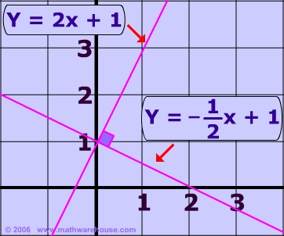
Perpendicular Lines
Lines that intersect at right angles are called perpendicular lines.
The slopes of perpendicular lines are opposite reciprocals.

Slide 5
Opposite Reciprocal
If slope is m = 4
1. OPPOSITE – change the sign of the slope
-4
2. RECIPROCAL – flip the slope
-$\frac{1}{4}$

Slide 6

Equations of Perpendicular Lines
Y = $\frac{1}{2}$x + 3
Y = - 2x – 5
Y = - $\frac{2}{3}$x – 6
Y = $\frac{3}{2}$x + 23

Slide 7
Finding Equations through Points
REMEMBER Y = M X + B
PLUG IN EVERYTHING YOU KNOW
IF GIVEN POINT (2,3) AND M = 4 THEN
3 = 4 (2) + B
We don’t know B, so we must solve for B.
3 = 8 + B ← subtract 8 on both sides
B = -5

