Slide 1
Proportions: Comparing Ratios
January 9, 2013
Mrs. McKay
Pre-Algebra

Slide 2
PROPORTION
When two ratios are equal to each other
Ex. 1 to 2 is the same as
10 to 20

Slide 3
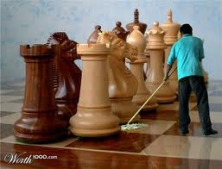
Something is not Quite RIGHT!

Slide 4
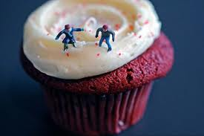
Something is not Quite RIGHT!

Slide 5
Something is not Quite RIGHT!

Slide 6
Living in a Disproportionate World
When ratios are NOT equal, they are disproportionate.

Slide 7
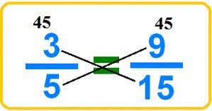
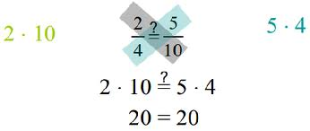
How to Compare Ratios?
See if the simplest forms are equal
Put the ratio in fraction form
Simplify the ratio to the simplest form – reduce the fraction
LOOK at the ratios – Are they the same? If YES, this is a proportion
COMPARE SIMPLEST FORM (reduced form)
CROSS-MULTIPLY

Slide 8
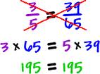
Cross Multiply

Slide 9
Completing Proportionate Tables
Angelfish | 4 | 8 | 24 | 20
Tigerfish | 3 | 6 | 18 | 15

Slide 10
Completing Proportionate Tables
Boys | 2 | 4 | 6 | 8
Girls |  | 16

Slide 11
Completing Proportionate Tables
Angelfish | 4 | 8 |  |  | 20
Tigerfish |  |  | 16 | 18

Slide 12
Looking Forward
https://www.youtube.com/watch?v=rpci5WLykVU

Slide 13
Word Problems and Proportions
A job pays $56 for 8 hours of work. How much money does the job pay per hour?

