Slide 1
Population Sampling
Mrs. McKay
March 13, 2013

Slide 2
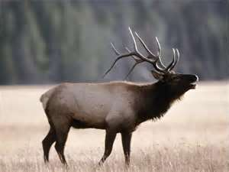

Slide 3
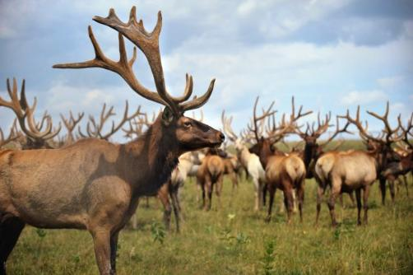

Slide 4
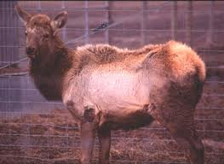

Slide 5
Vocabulary
Population – the entire group

Slide 6
Sample- a study of a part of the population or entire group

Slide 7
Random sample – members of the population are chosen at random

Slide 8
Convenience sample- uses members of the population that are readily available

Slide 9
Biased sample – a sample that does not fairly represent the population

