Slide 1
UNDERSTANDING SLOPE
Mrs. McKay
February 13, 2013

Slide 2
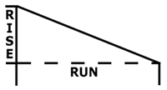
SLOPE
A measure of a line’s steepness AND
the ratio of rise to run.
$\frac{rise}{run}$= $\frac{\text{vertical} \text{change} (y2 −y1)}{horizontal change (x2−x1)}$

Slide 3
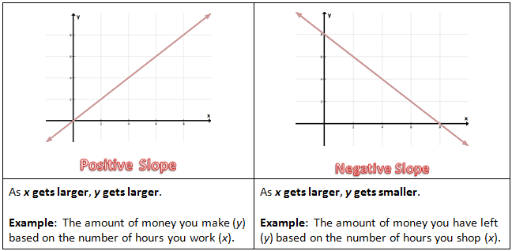
SLOPE
Positive Slope – if the line rises from left to right
Negative Slope – the line falls from left to right

Slide 4
SLOPE FORMULA
$$\frac{ (y2 −y1)}{ (x2−x1)}$$
TO FIND SLOPE YOU MUST HAVE TWO POINTS!!!!!
TO FIND SLOPE YOU MUST HAVE TWO sets of coordinates!!!!!
TO FIND SLOPE YOU MUST HAVE TWO POINTS!!!!!
TO FIND SLOPE YOU MUST HAVE TWO sets of coordinates!!!!!

Slide 5
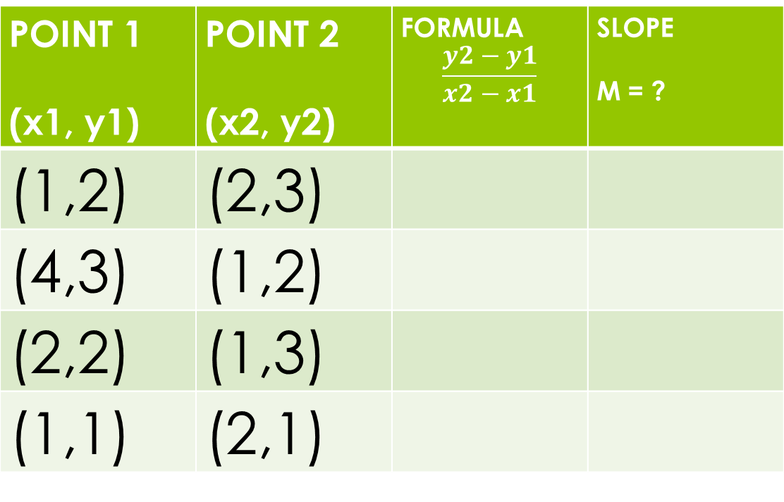
SLOPE PRACTICE!!!
POINT 1 (x1, y1) | POINT 2 (x2, y2) | FORMULA $$\frac{y2−y1}{x2−x1}$$ | SLOPE M = ?
(1,2) | (2,3)
(4,3) | (1,2)
(2,2) | (1,3)
(1,1) | (2,1)

Slide 6
