Slide 1
Writing Equations
Mrs. McKay

Slide 2
Creating Equations
Sometimes you will need to find the equation of a line given its graph.
Example - To write the equation of the line in form Y = MX + B, what info do we need?
Slope - m
Y – Intercept - b

Slide 3
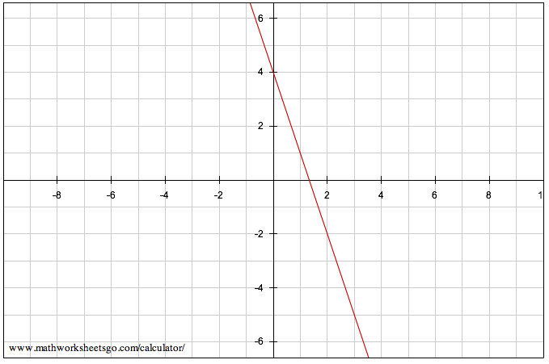
WHAT IS THE SLOPE?
WHAT IS THE Y-INTERCEPT?

Slide 4
Writing Equations
Y = m x + b
If I give you slope m = 2
B = 4
PLUG THEM IN
Y = 2X + 4

