Slide 1
CONGRUENT TRIANGLES
Mrs. McKay
May 7, 2013

Slide 2
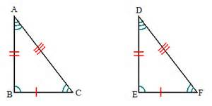

Slide 3
CONGRUENT TRIANGLES
Without measuring triangles, we can discover that triangles are congruent when …

Slide 4
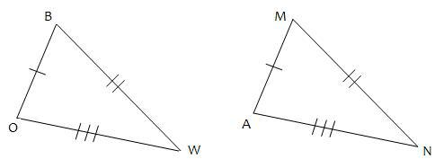
SSS (side side side)
1.— All three corresponding sides are equal in length.

Slide 5
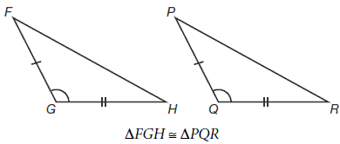
SAS (side angle side)
2.— A pair of corresponding sides and the included angle are equal.

Slide 6
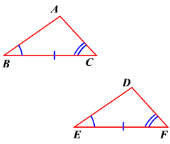
ASA (angle side angle)
3.— A pair of corresponding angles and the included side are equal.

Slide 7
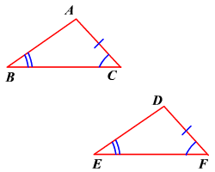
AAS (angle angle side)
4.— A pair of corresponding angles and a non-included side are equal.

Slide 8
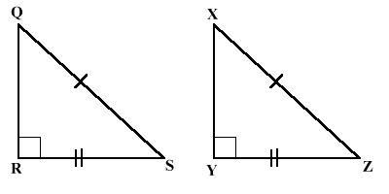
HL (hypotenuse and leg of a right triangle)
5.) — Two right triangles are congruent if the hypotenuse and one leg are equal.

Slide 9
Congruent Triangle Worksheet
You must have all FIVE sections filled in for credit.
You must have a picture (2 triangles) under each description

Slide 10
SAS (side angle side)

Slide 11
SSS (side side side)

Slide 12
ASA (angle side angle)

Slide 13
HL (hypotenuse and leg of a right triangle)

Slide 14
AAS (angle angle side)

