Slide 1
COLLECTING AND ANALYZING DATA
CHAPTER 7, SECTION 1
MEAN, MEDIAN, MODE & RANGE
Mrs. McKay
March 11, 2013

Slide 2
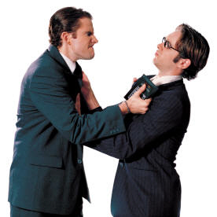
Imagine this Scenario
Kaleb was told the average wage at his new job is $10.00 per hour. He later discovers that they are only paying him $7.50 an hour! He then learns that most of the employees earn $7.50.
How is this possible? Should he be angry?

Slide 3
Vocabulary
Mean – the sum of data value divided by the number of data items
Median – the middle value of an odd number of data items arranged in order. For an even number of data items, the median is the mean of the two middle values.
Mode – the value or values that occur most often. when all the data values occur the same number of times, there is no mode

Slide 4
Vocabulary
Range – the difference between the greatest and least values
Outlier – an extreme value in a set of values that skews the data when finding the mean

Slide 5
When to use the Measures?
MEASURES of Central Tendency | MOST USEFUL WHEN
MEAN | The data are spread fairly evenly
MEDIAN | The data set has an outlier
MODE | The data involve a subject in which many data points of one value are important, such as election results

Slide 7
GUIDED PRACTICE
TURN TO PAGE 277
READ THE SCENARIO AND LOOK AT THE TABLE AT THE TOP OF THE PAGE

