Slide 1
Box-and-Whisker Plots
Mrs. McKay
March 12, 2013

Slide 2
Vocabulary
Box and Whisker Plots – a plot that uses a number line to show the distribution of a set of data
Lower Quartile – the median of the lower half of data
Upper Quartile – the median of the upper half of data
Interquartile Range – the difference between the lower and upper quartiles

Slide 3
Why use a Box-and-Whisker??
To analyze how data in a set are distributed
To compare two sets of data

Slide 4
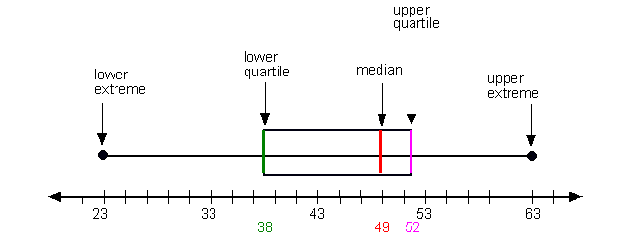
Picture of Box-and-Whisker

Slide 5
How to Make a Box-and Whisker Plot
Arrange the data from least to greatest.
Make a number line for that data.
Find the median of the entire set of data. MIDDLE LINE IN BOX
Find the lower quartile (the median of the lower half). LEFT SIDE OF BOX
Find the upper quartile (median of the upper half). RIGHT SIDE OF BOX
Find the smallest and largest values. WHISKERS

Slide 6
Example #1
How do we represent this data in a box and whisker plot?
19, 21, 17, 20, 17, 28, 26, 23, 29
Go to PDF for example

