Slide 1
Vocabulary Review 10.3
Mrs. McKay

Slide 2
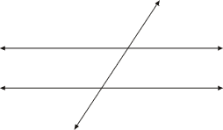
TRANSVERSAL

Slide 3
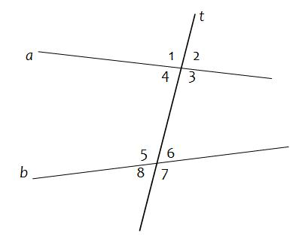
Transversal

Slide 4
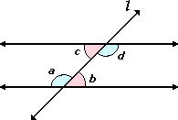
Alternate Interior Angles

Slide 5
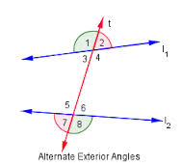
Alternate Exterior Angles

Slide 6
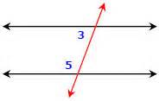
Same Side Interior Angles

Slide 7
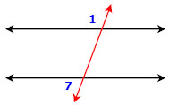
Same Side Exterior Angles

Slide 8
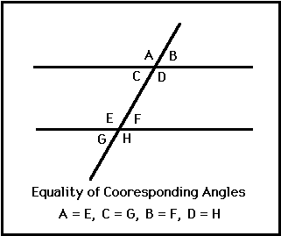
Corresponding Angles

