Slide 1
10.1 Review
Mrs. McKay
May 1, 2013

Slide 2
Section 10.1
• Triangle Sum Theorem
• remote interior angles of a triangle
• Exterior Angle Theorem
• Exterior Angle Inequality Theorem

Slide 3
Triangle SUM Theorem
The sum of the interior angles of any triangle is equal to 180 degrees.

Slide 4
Exterior Angles
Interior Angles
Angles OUTSIDE the triangle
Angles INSIDE the triangle

Slide 5
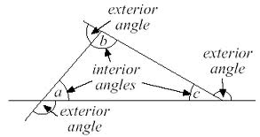

Slide 6
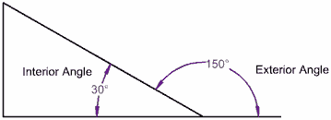

Slide 7
Interior Angles
2
1
3
5
6
4
Exterior Angles

Slide 8
Exterior Angle Theorem
The measure of an exterior angle of a triangle is equal to the sum of the measures of the two non-adjacent interior angles of the triangle.

Slide 9
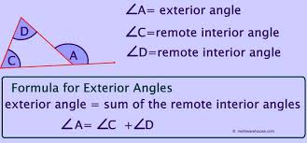
Exterior Angle Theorem

Slide 10
Exterior Angle Inequality Theorem
The measure of an exterior angle of a triangle is greater than the measure of either opposite interior angle.

